Slide 1
Assessing and extending the validity of multi-scale simulation algorithms for infectious disease processes
Thayer Anderson

Slide 2
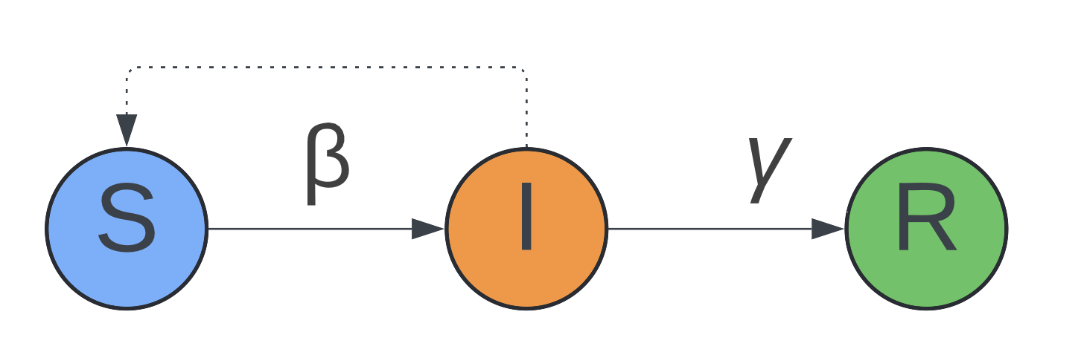
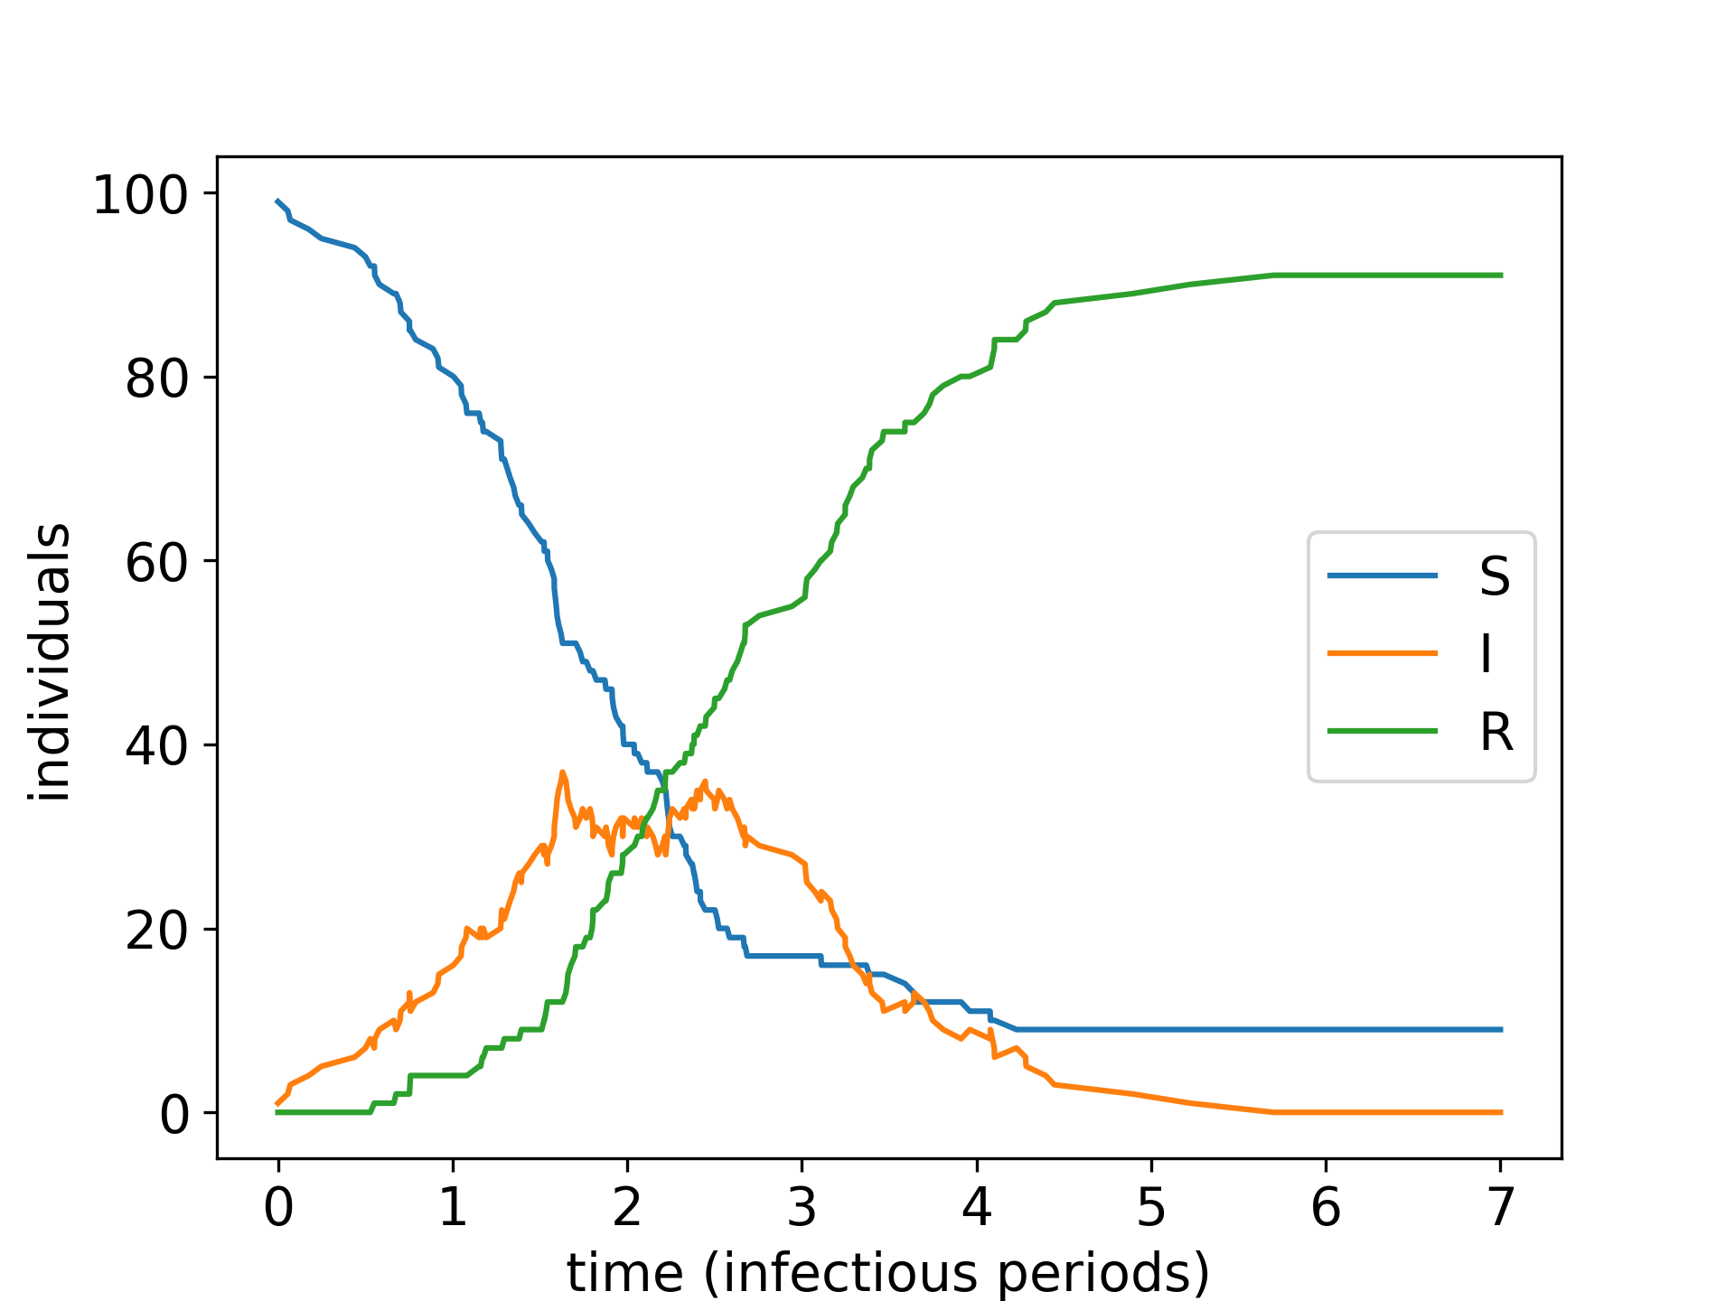
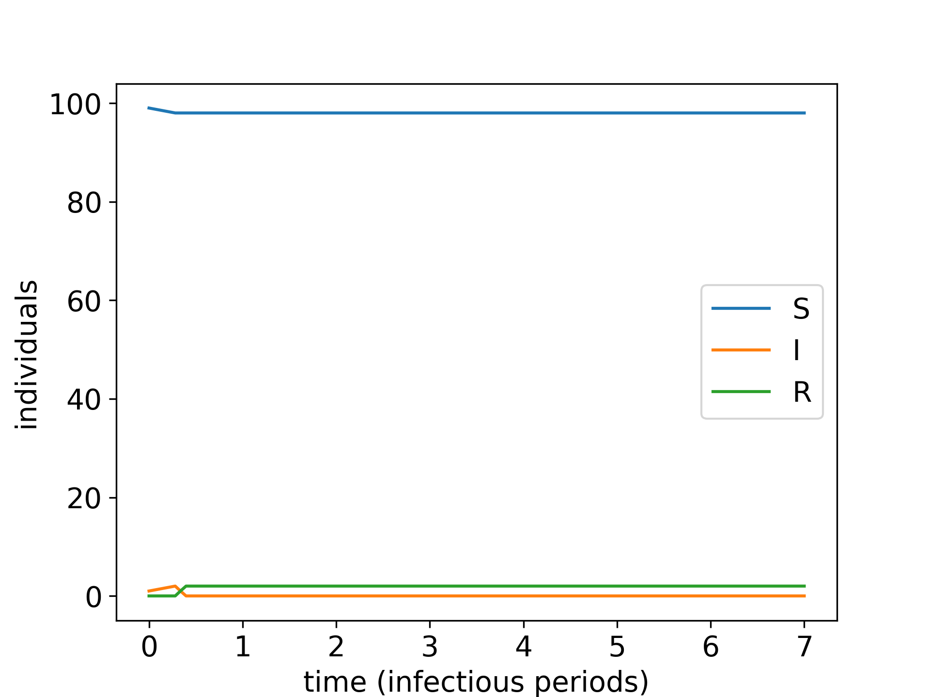
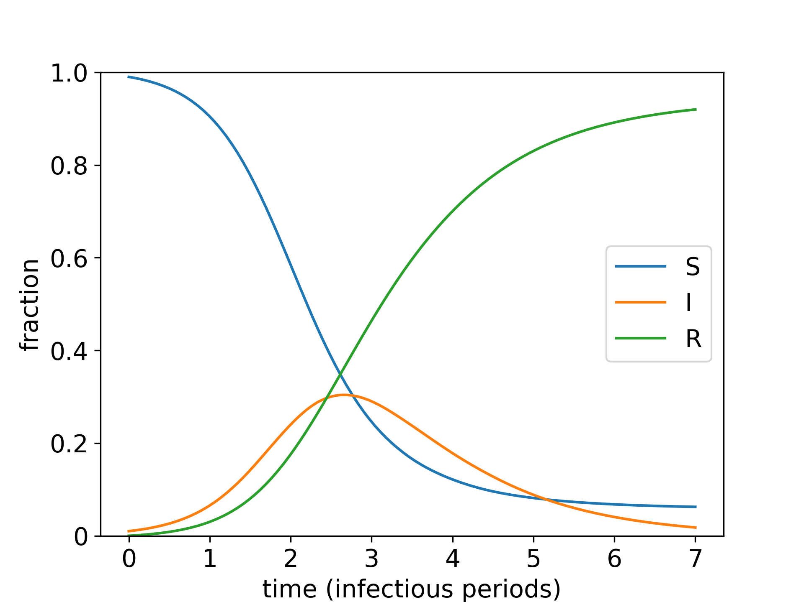
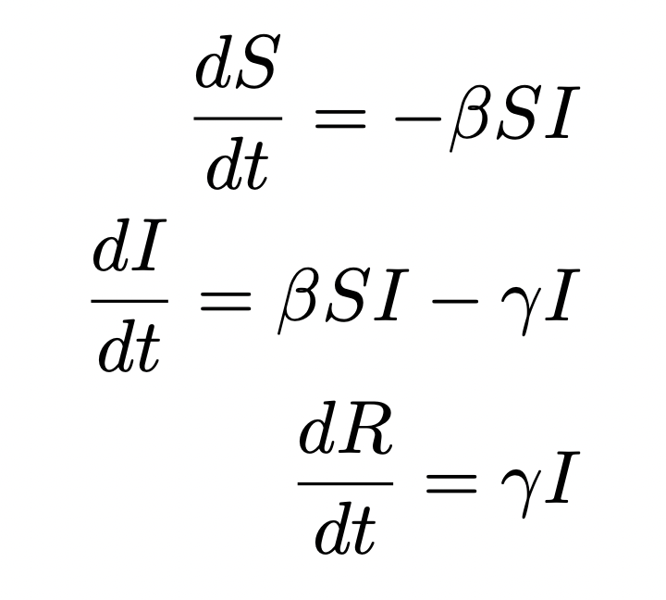
Infectious disease dynamics

Slide 3
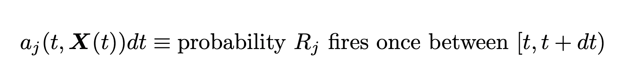
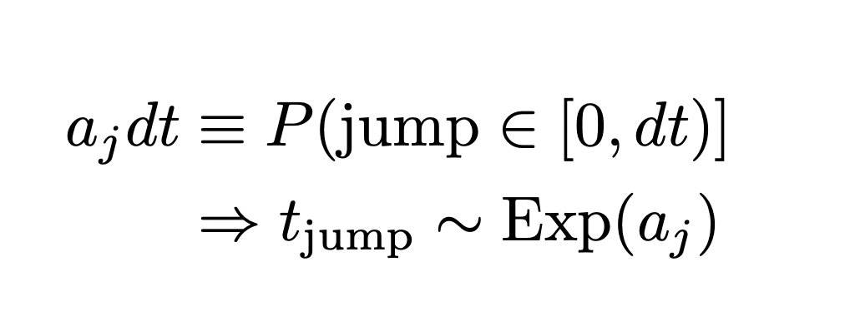
Stochastic foundations of chemical kinetics
Replace differential equations with the probability-propensity relationship:
Gillespie’s trick
Stochastic simulation algorithm
Notes:
PROPENSITY CONSTANT BETWEEN STEPS

Slide 4

HIV dynamics
X
CD4+ T-cell
Infected cell (strain i)
Latent cell (strain i)
Virus particle (strain i)
Different kinds of stochasticity
(1) Rare events
Drug resistant mutation (one mutation per between ten thousand and ten million infection events)
Entering latency (~1/million cells)
Exiting latency (~4/ten thousand cells per day)
(2) Uncertain drug adherence
(3) Low population critical processes with absorbing states
Establishment of strain given single cell
Y_{i}
Z_{i}
i
i
X
Y_{i}
Z_{i}
Y_{j}

Slide 5
Multi-scale problem:
~10¹⁰ CD4+ target cells are born every day
Mutations can be as rare as ~1/ten million infection events
Haseltine-Rawlings partitioning (2002)
Tau-leaping (Gillespie, 2001)
Idea:
Partition between “fast” and “slow” processes
Simulate the “slow” stuff stochastically
Idea:
Leap in increments of time, not events

Slide 6
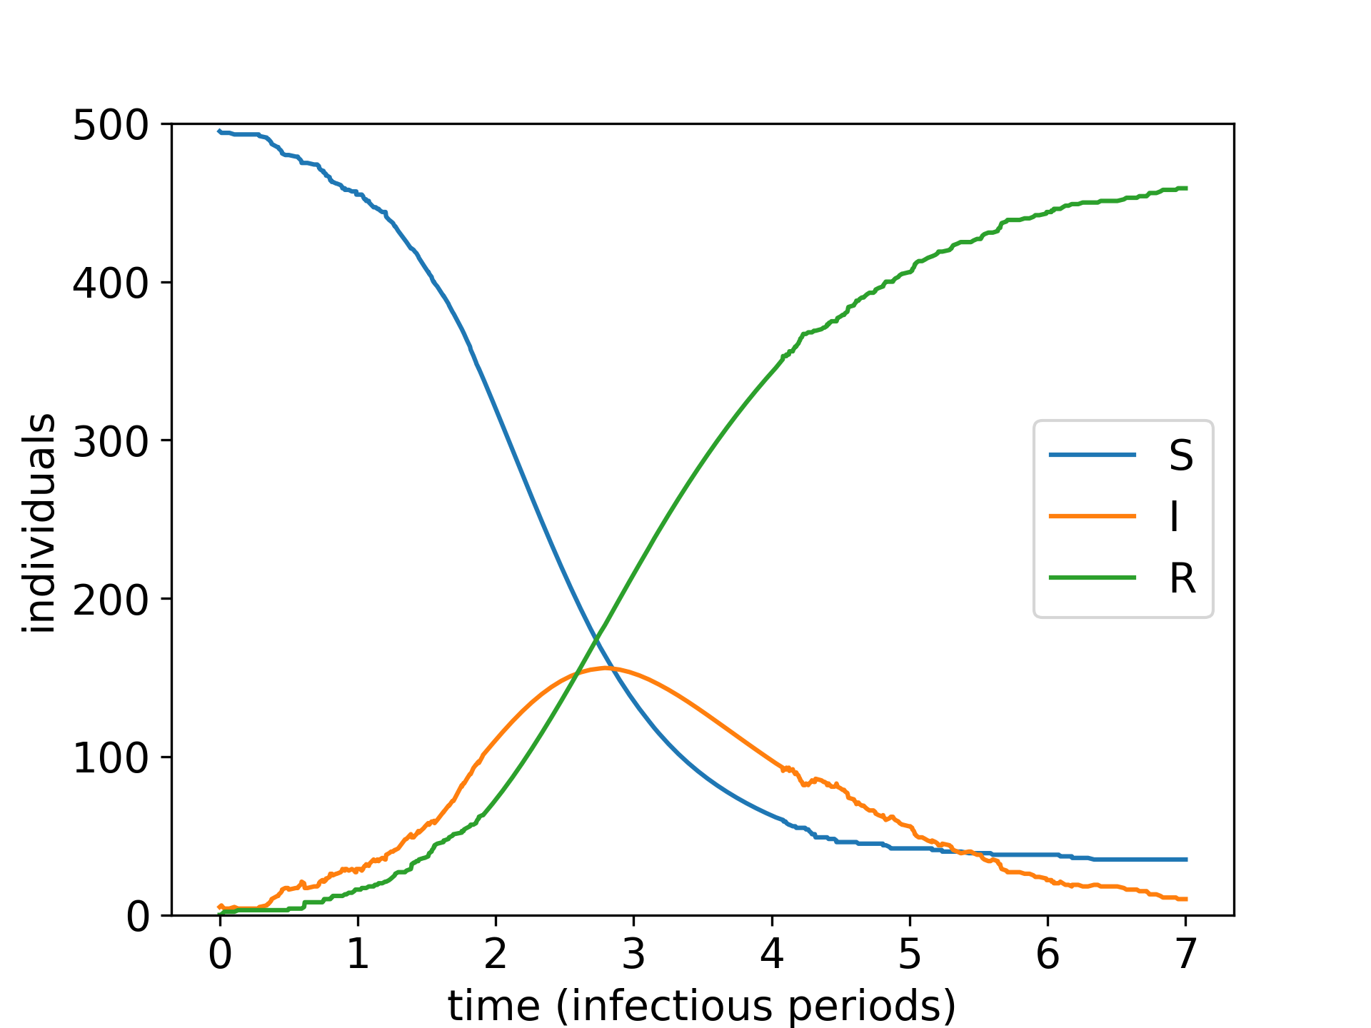
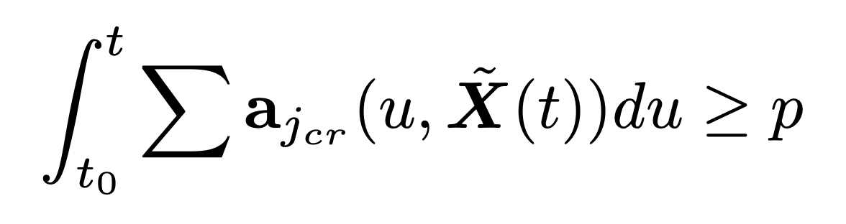
Partitioning
Separate scales by a threshold rate
Solve “fast” problem with integration
=> time-varying rates
Solve “slow” problem with implicit Gillespie for time of next reaction t
Threshold → ∞, Gillespie simulation
Threshold → 0, ODE

Slide 7
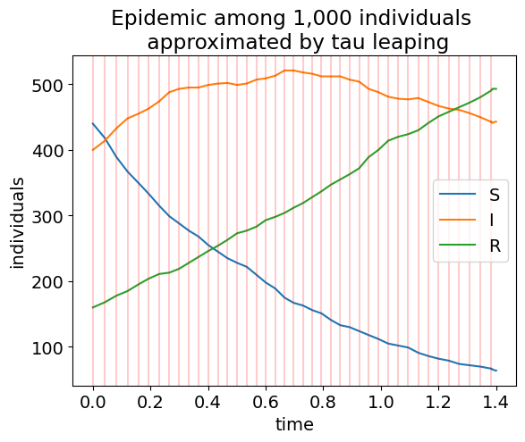
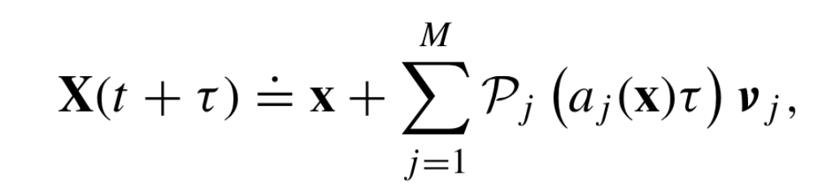
Tau-leaping
Find a timescale over which propensities are ~constant:
Leap over that timescale:
Control parameters:
𝜖 = maximum change in any propensity in leap
Limits:
As 𝜖 → 0, recover Gillespie simulation
As system size → ∞, recover Euler’s method
Simulation time is proportional to the rate at which the propensities are changing
Notes:
If you have ever done a “discrete time simulation” with a constant time step, you were essentially doing tau-leaping without an adaptive step size or a critical process framework.

Slide 8
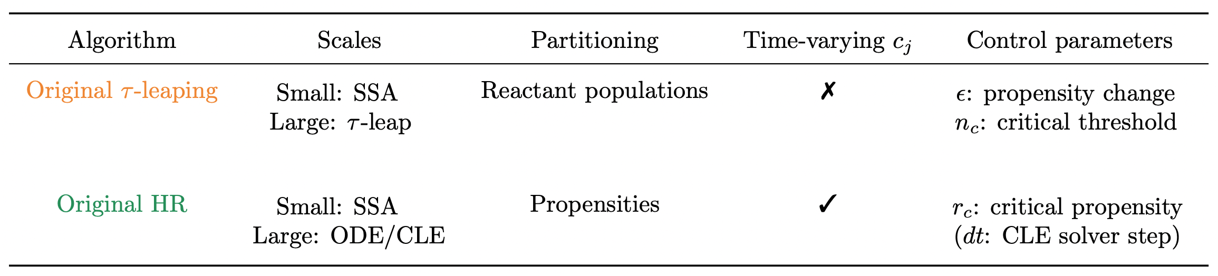

Slide 9
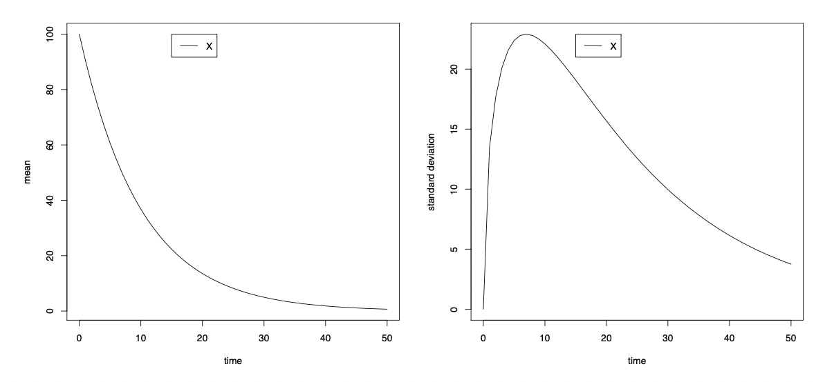
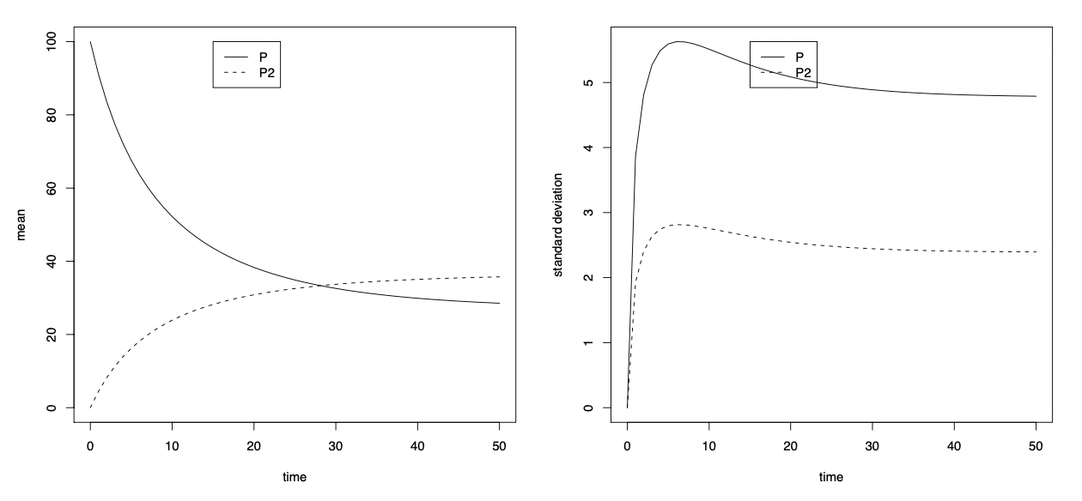
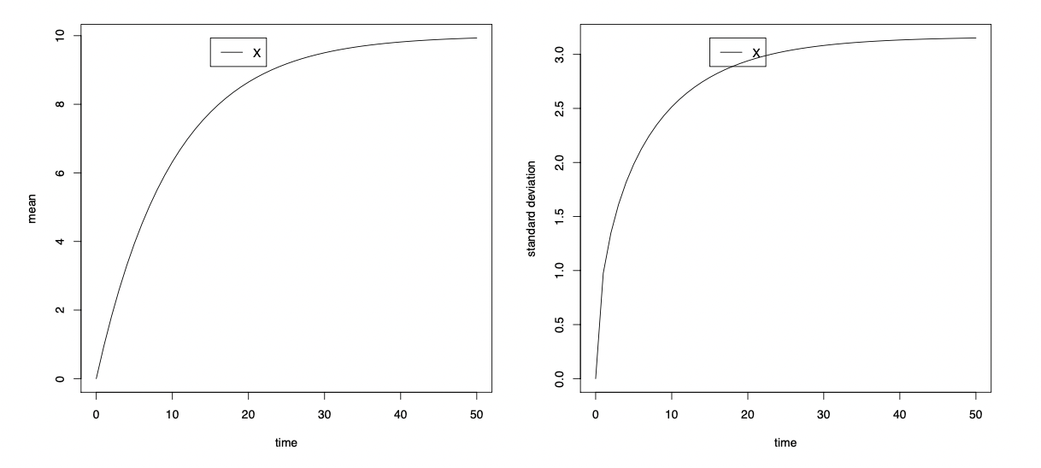
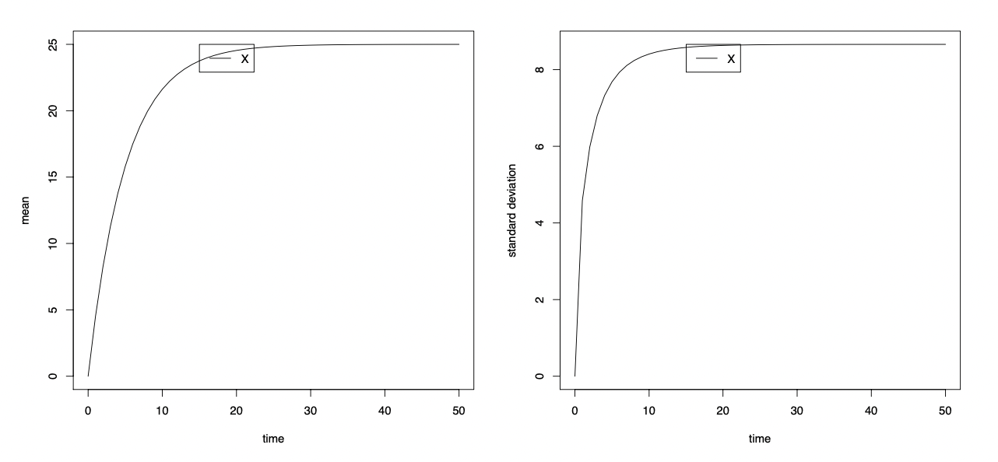
Verification
Systems Biology Markup Language (SBML) discrete model test suite
Birth-death
Dimerization
✓
✓
✓
✓
Immigration-death
Batch immigration
✓
✓
✓
✓

Slide 11
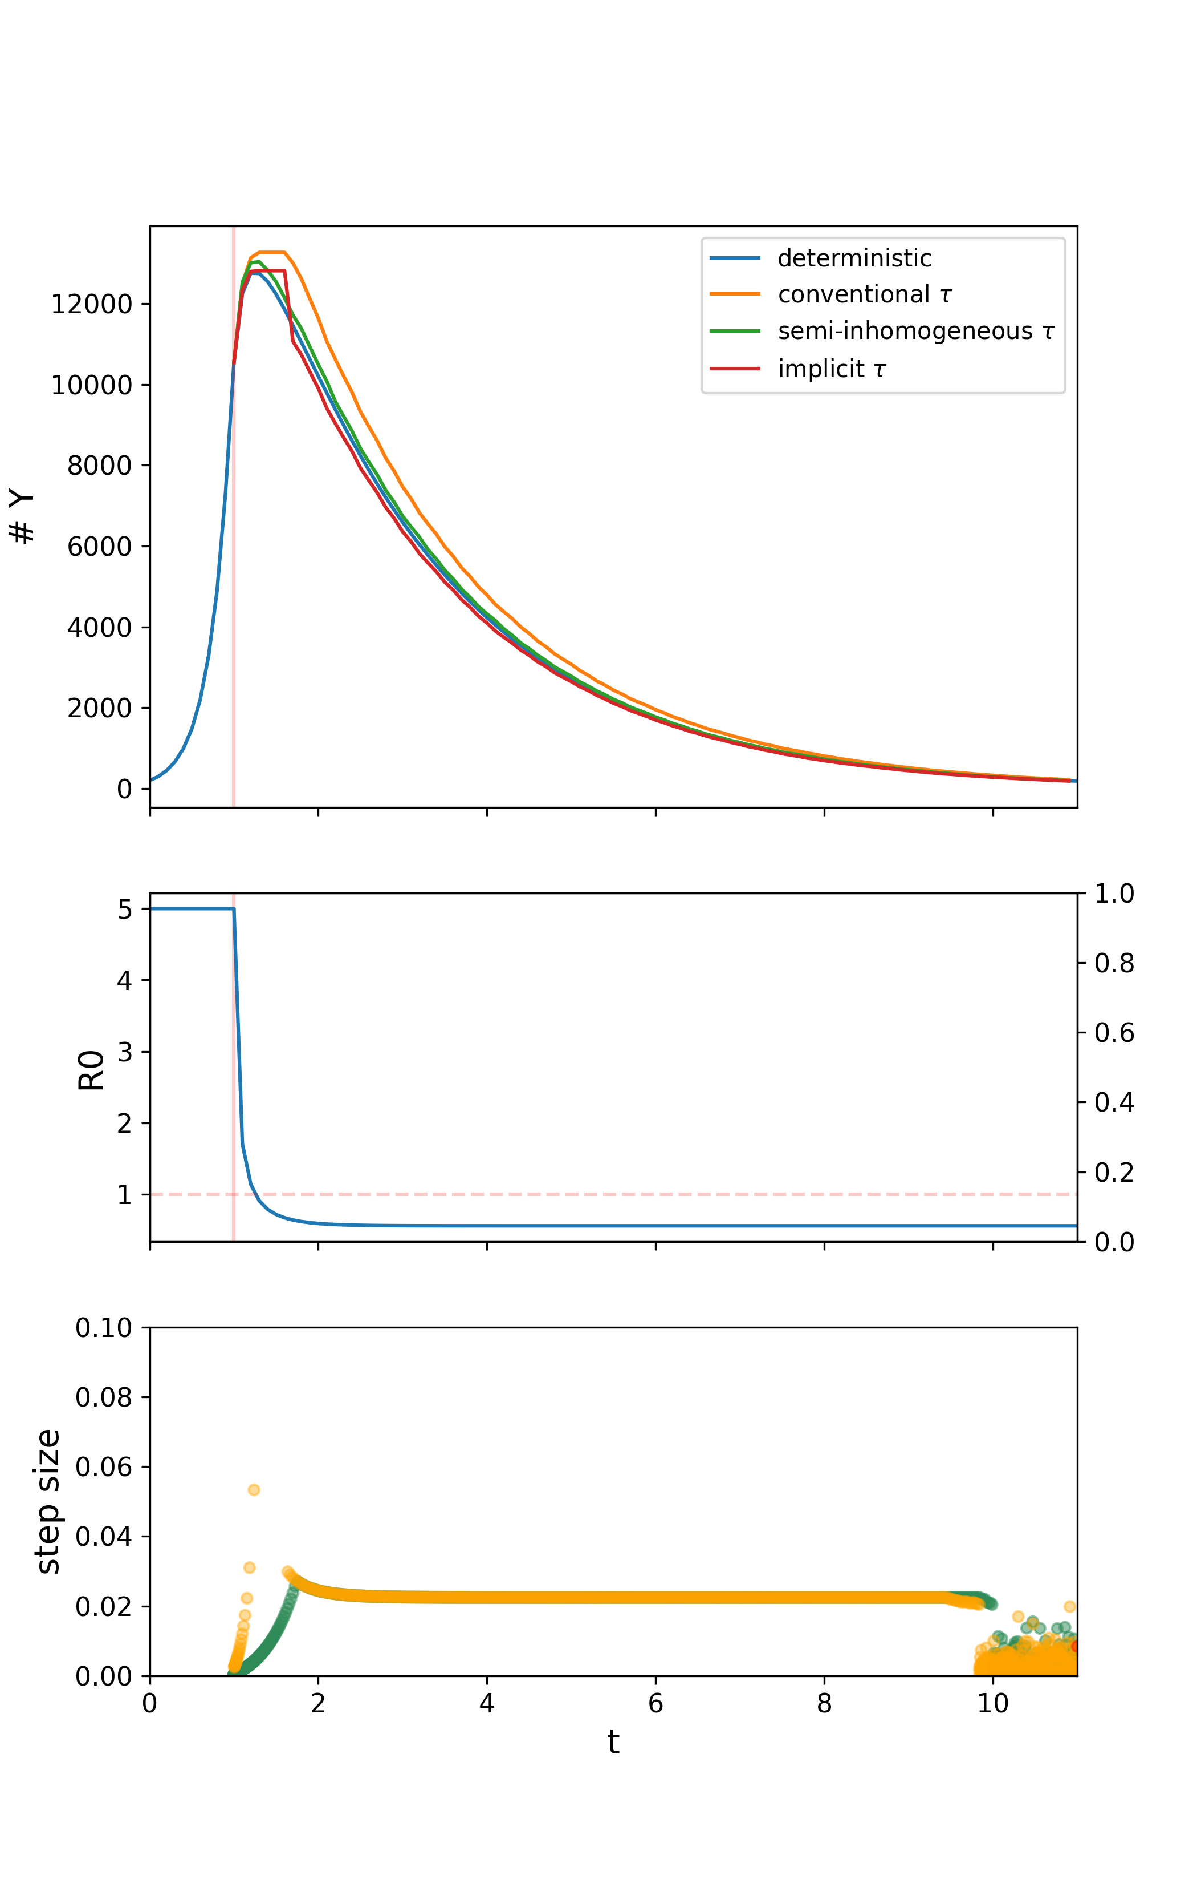
Interventions & leaping
If rate constants are changing in time, the leap condition should be modified
Adjustment for piecewise monotonic time-dependence (green)
AUC ~ probability of latent cell. Unmodified => 10% error in AUC

Slide 12
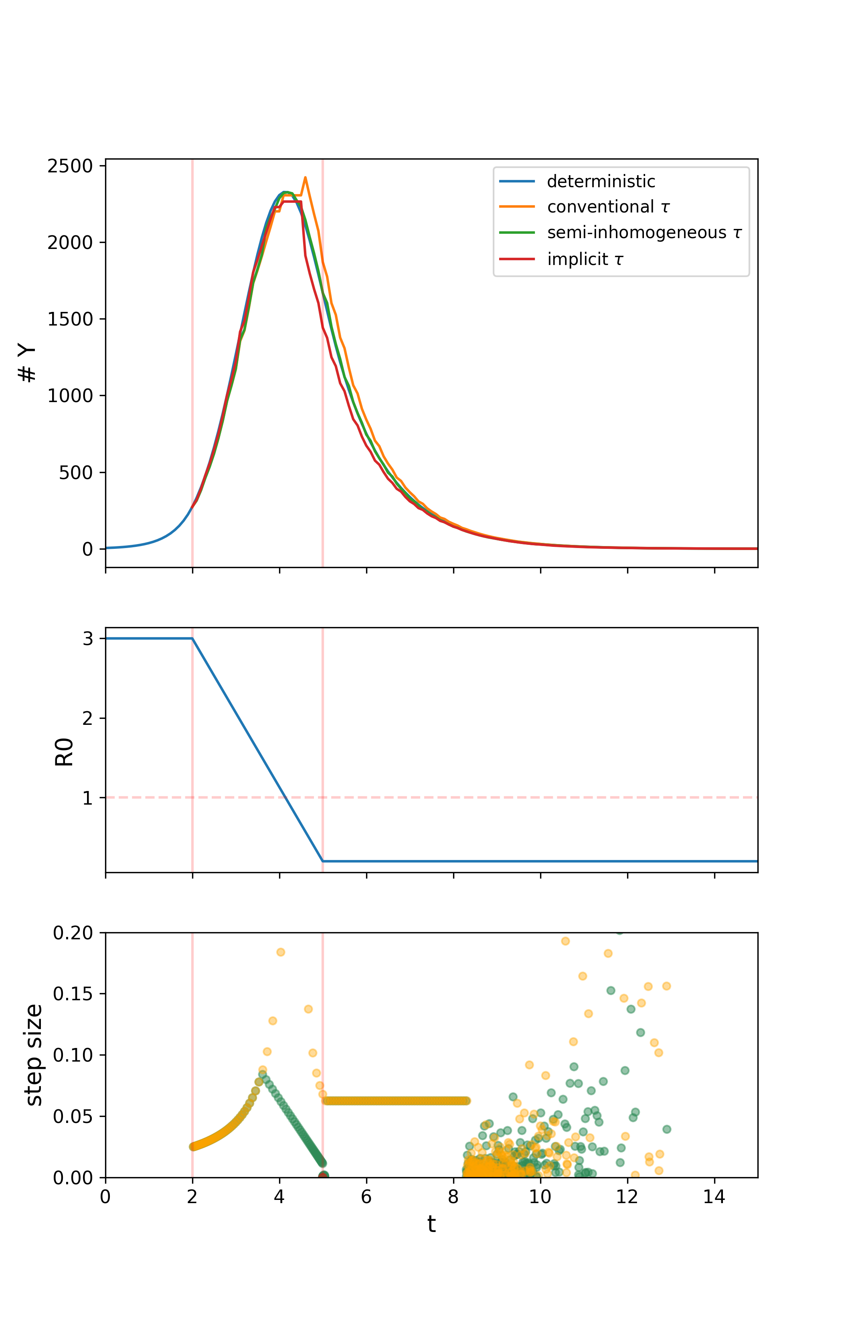

Interventions & leaping
If rate constants are changing in time, the leap condition should be modified
Adjustment for piecewise monotonic time-dependence (green)
AUC ~ probability of escaping intervention scope? ~5% error in AUC

Slide 14
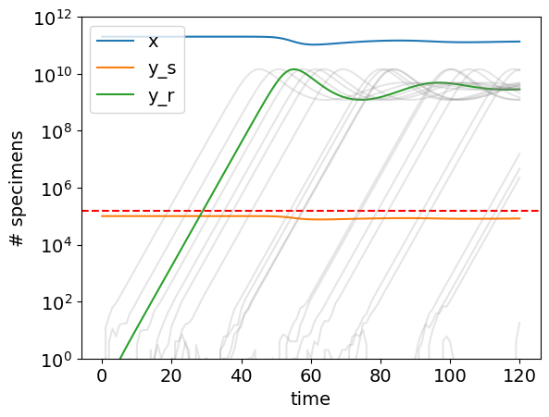
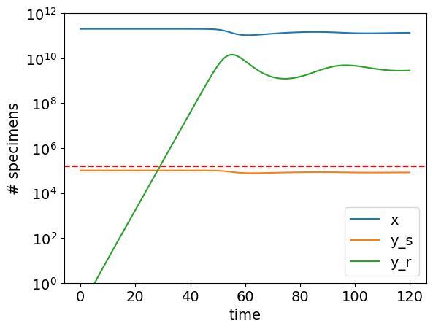
Mutant emergence
s
X
Y_{s}
Z_{i}
Wildtype infected cells sustained at a low level by reactivation of latently infected cells
Drug inhibits >75% of wildtype infections
Mutation to resistant subtype
Parameters:
y*: equilibrium population of y_{s}
f_{rep}: fraction of y* sustained by replication
μ: mutation rate
R_{μ}: reproductive number of mutant
Y_{r}
r
Notes:
Long, low shoulder of COVID-19
Two kinds of stochasticity:
Rare events
Low population critical processes with absorbing states

Slide 15
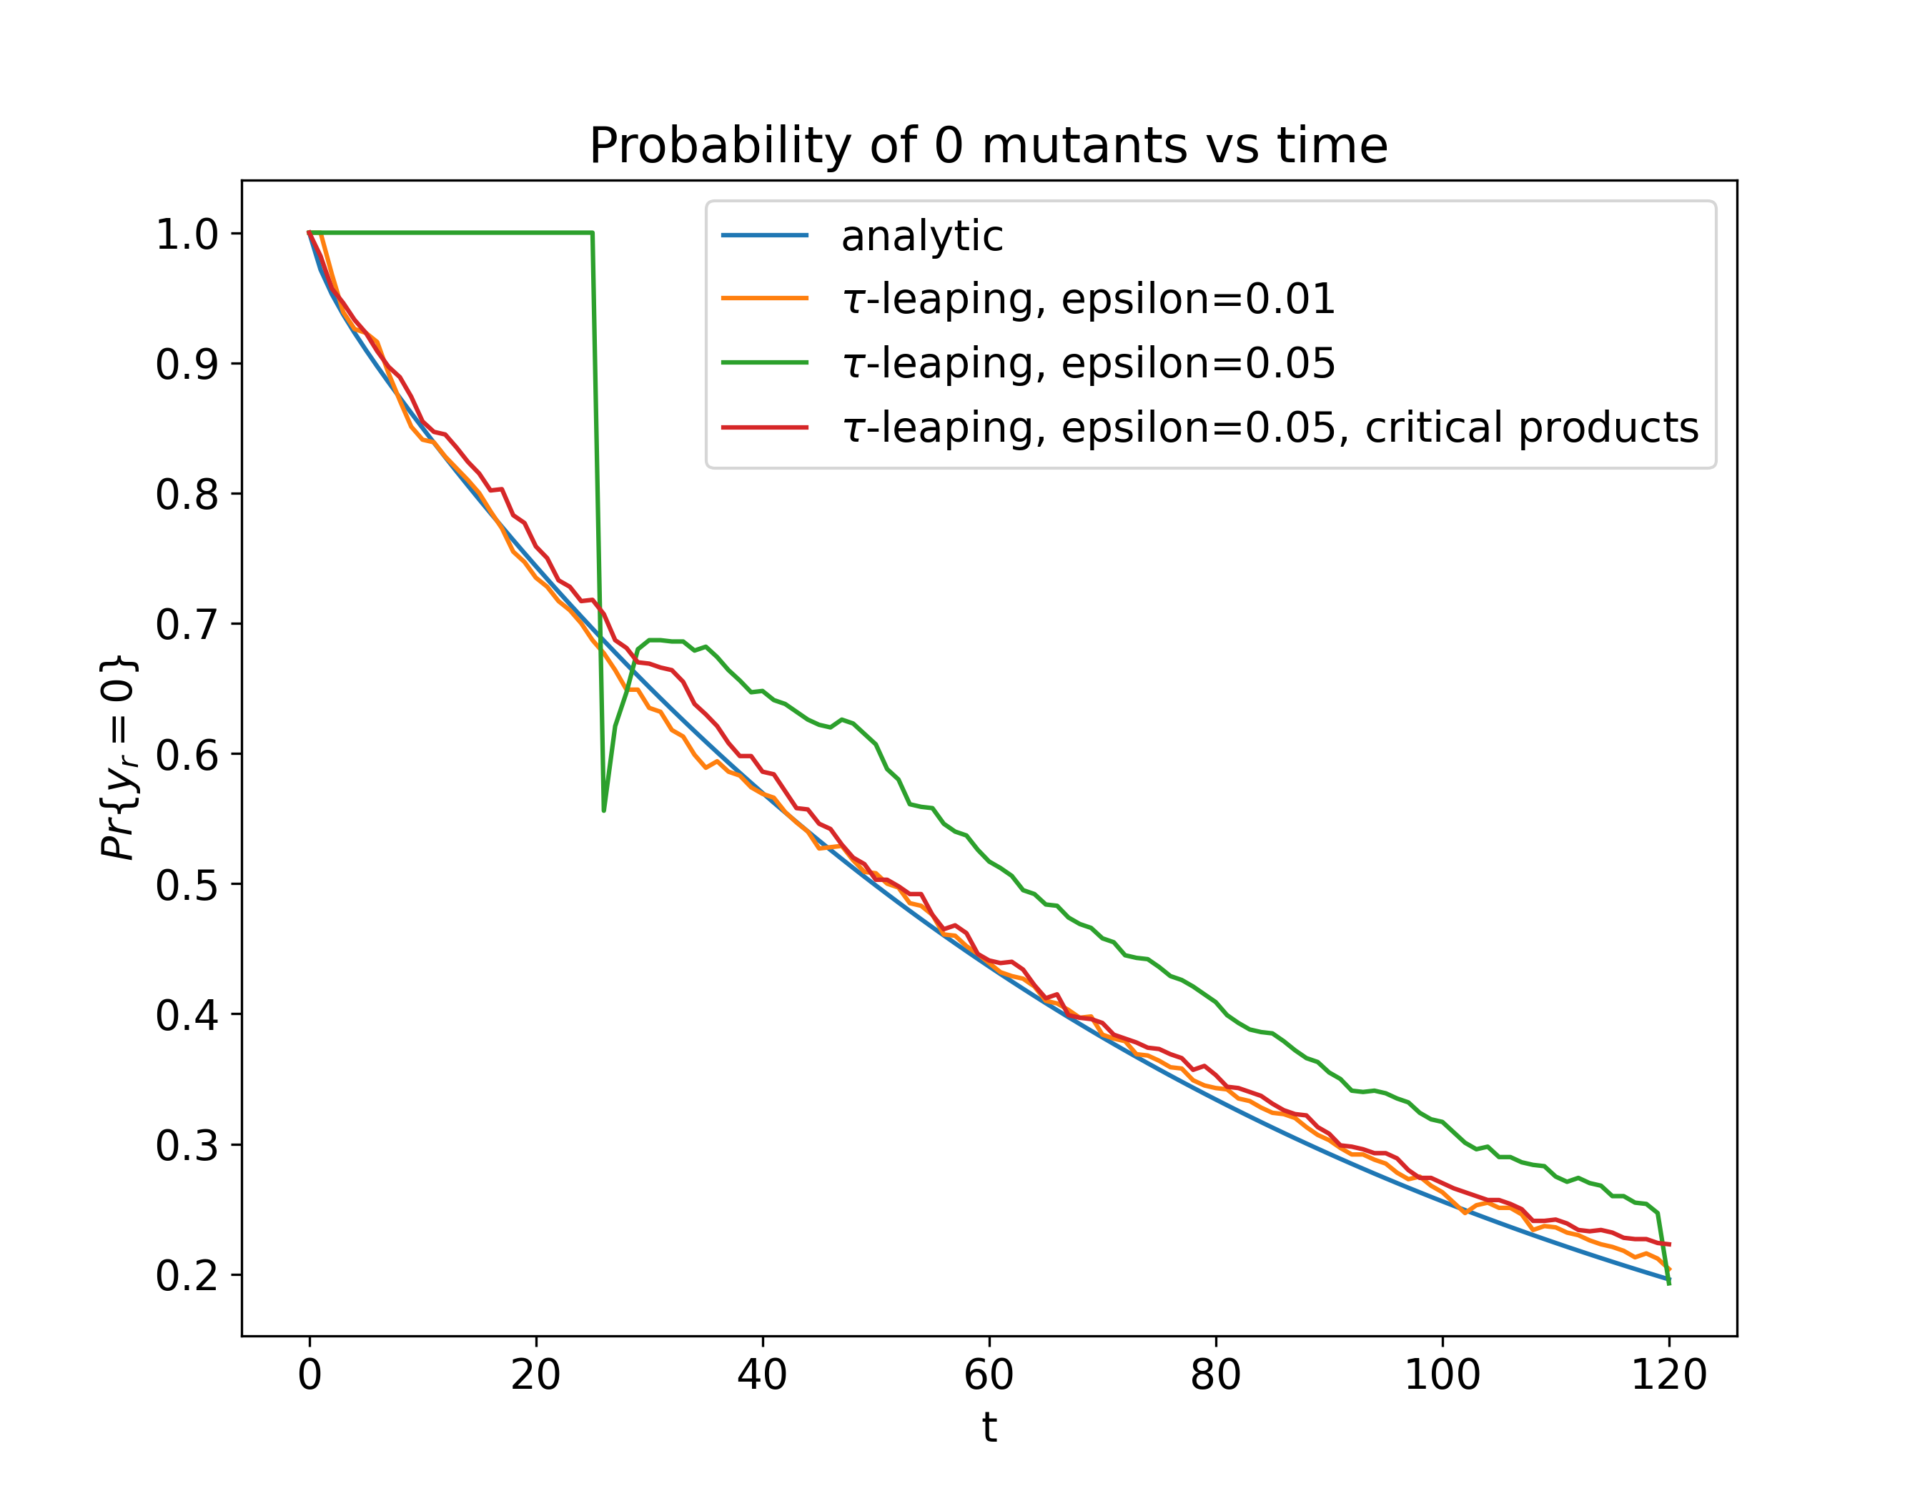
Mutant emergence & leaping
Species extinction and creation inherently violate leap condition
Tau leaping by default only protects species extinction

Slide 17
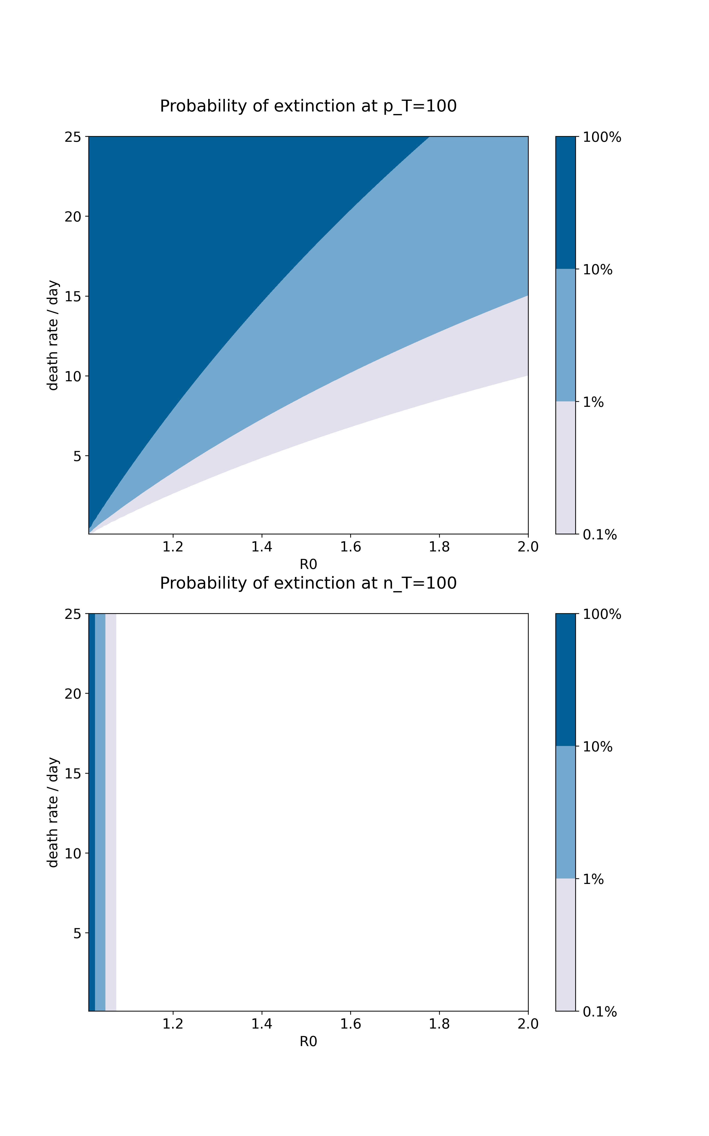
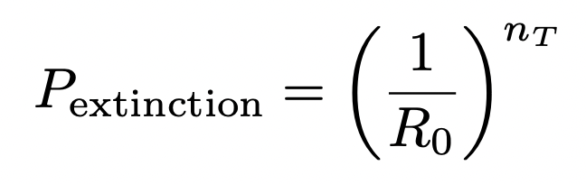
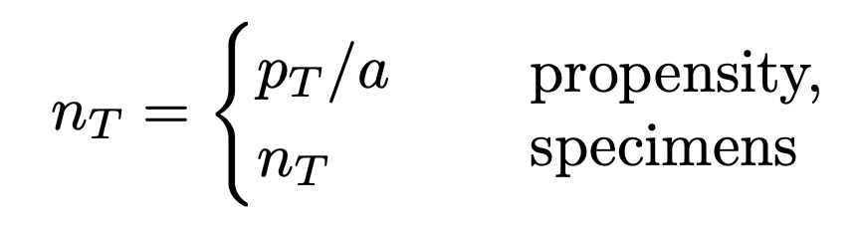
Mutant emergence & partitioning
Partitioning by propensity neglects likely extinctions near threshold

Slide 19
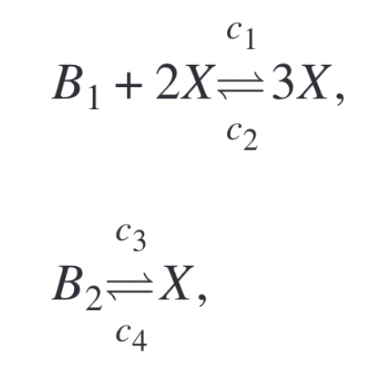
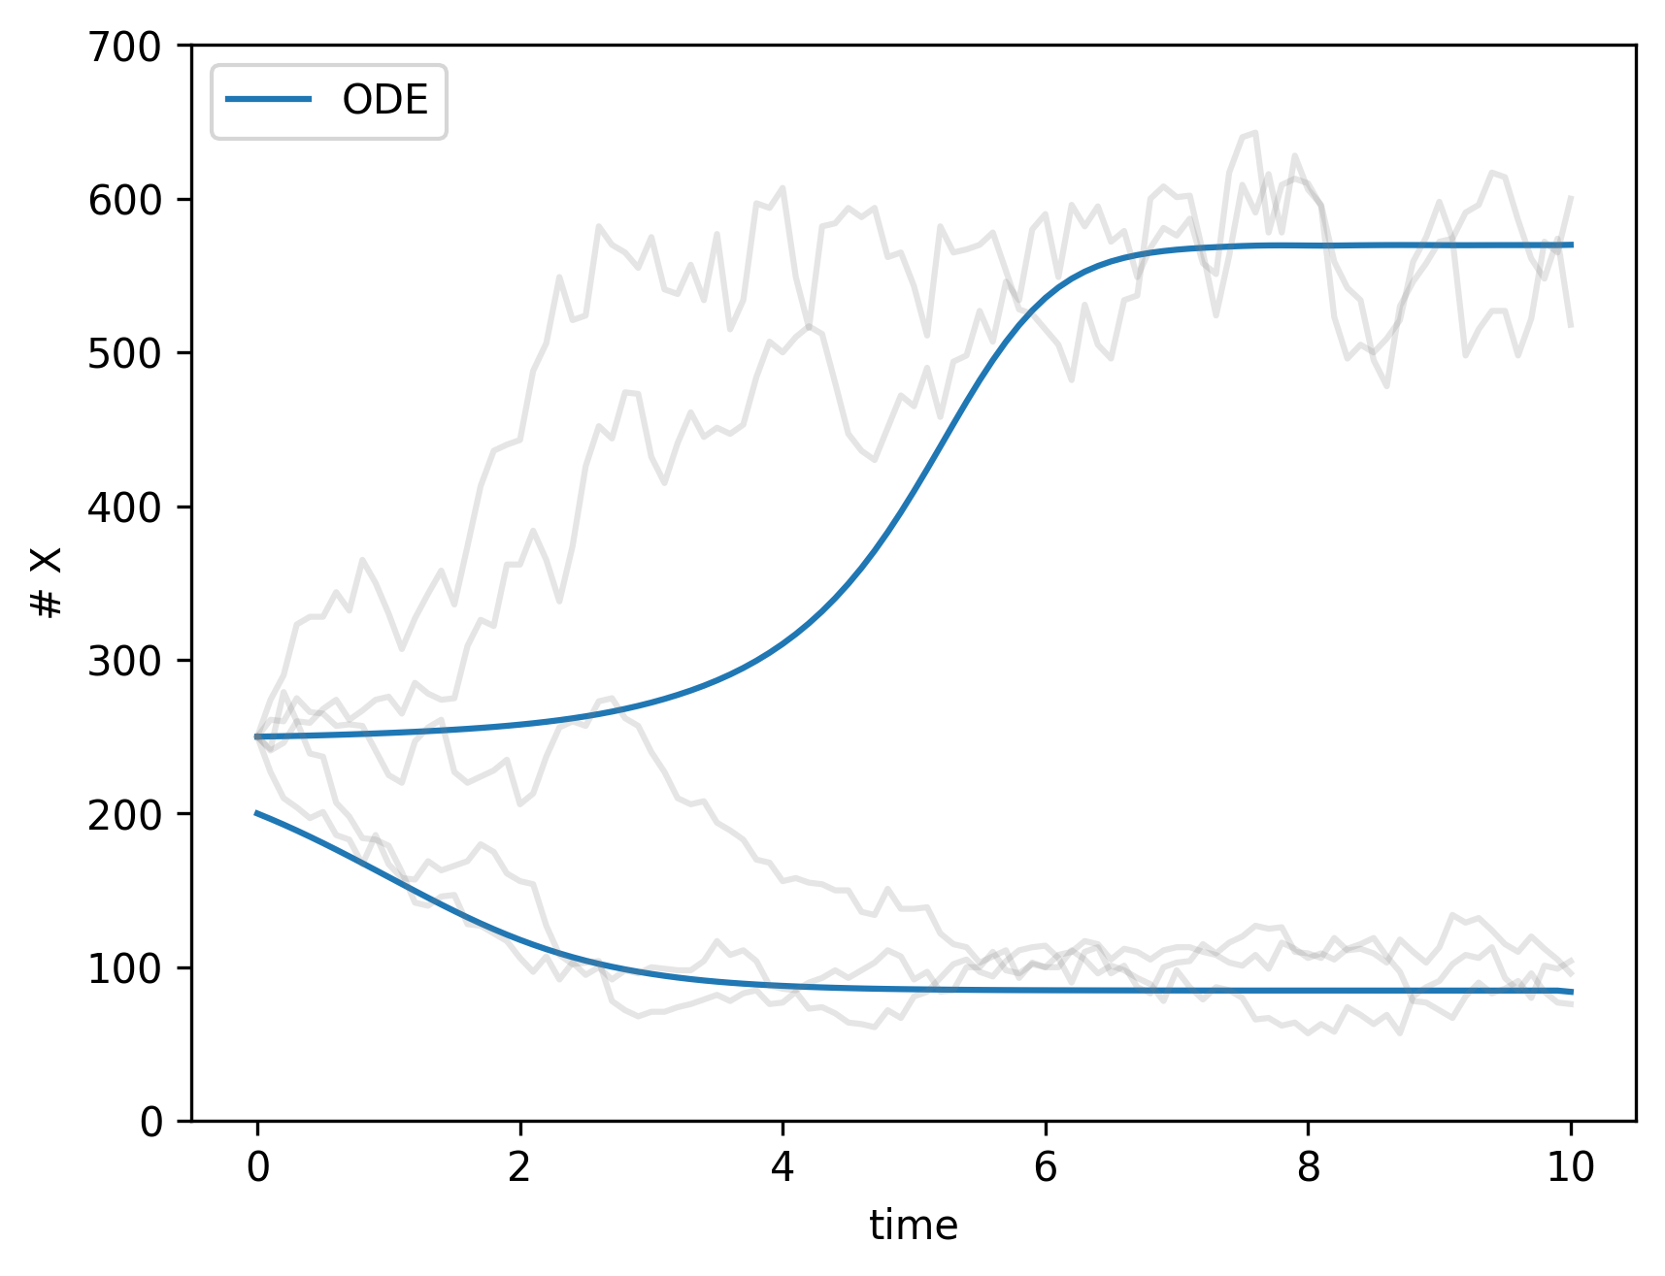
Equilibria & partitioning
Schlögl system
Macroscopic bistability requires randomness at larger scale
Stochastic differential equations. Euler-Maruyama method

Slide 20
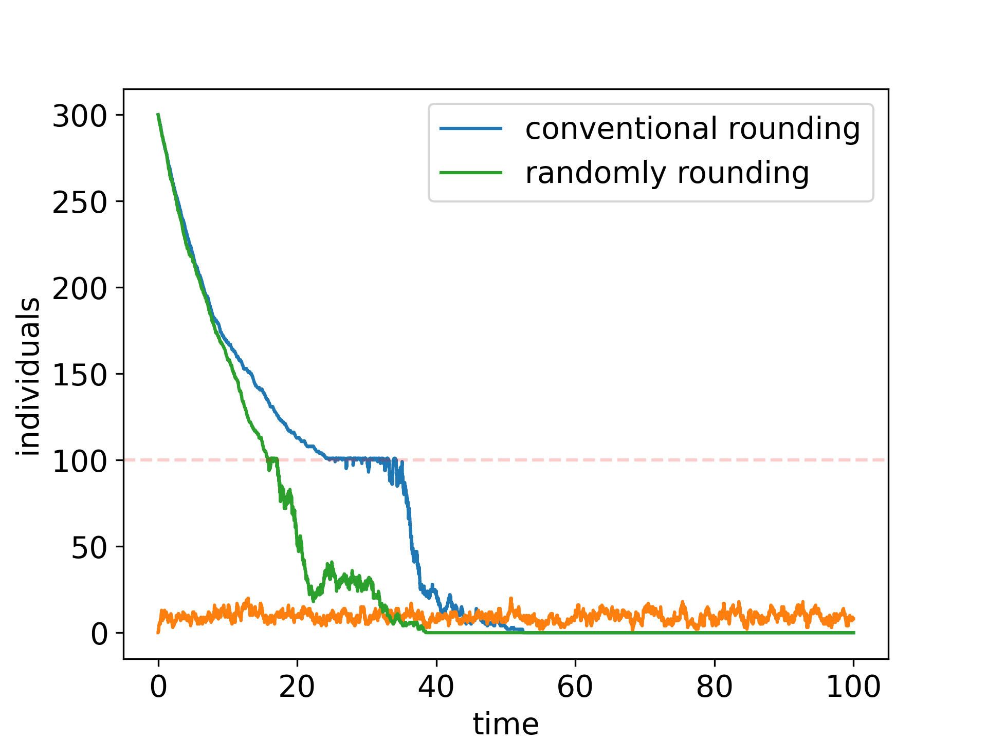
Rounding & partitioning
Integration (even stochastic) uses continuous variables for “fast” system
But must round populations for “slow” system
“Persistent shortfall bias”

Slide 21
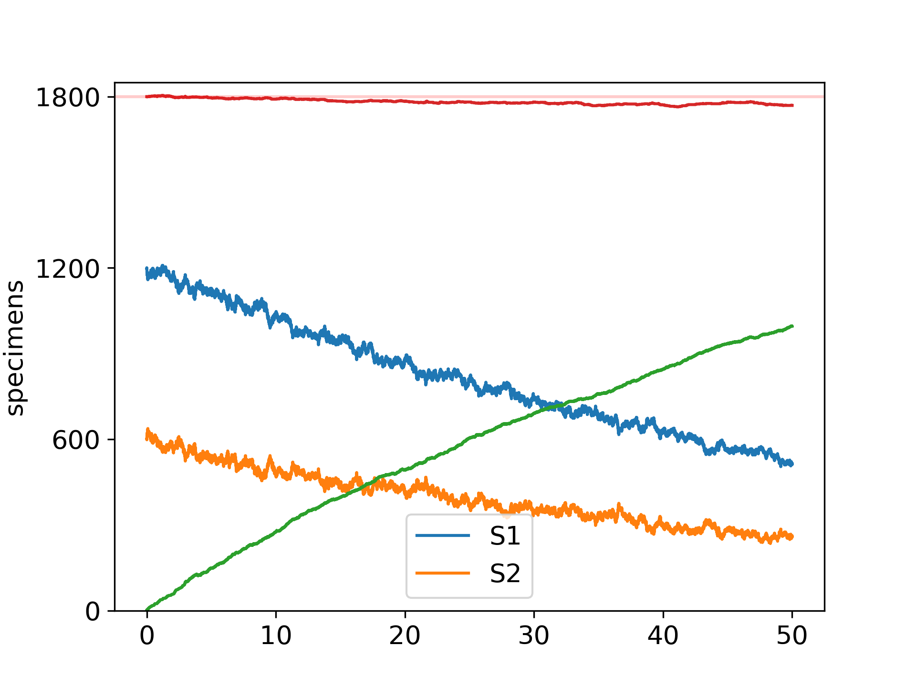
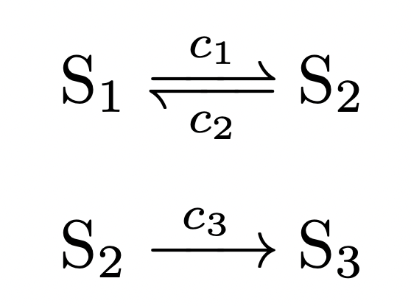
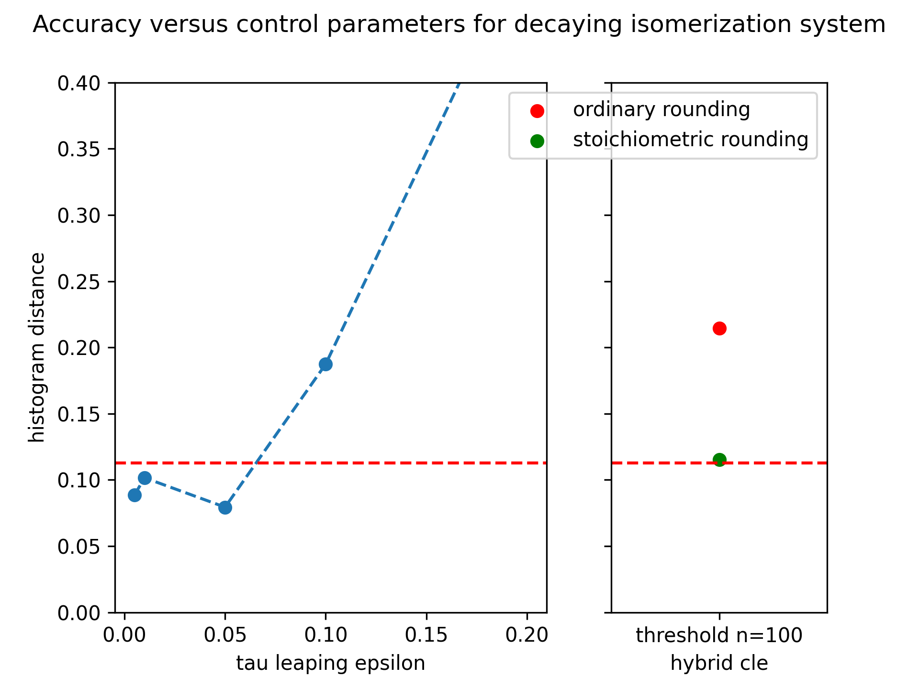
Rounding & partitioning
Integration (even stochastic) uses continuous variables for “fast” system
But must round populations for “slow” system
“Persistent shortfall bias”
Non-realizable states

Slide 22
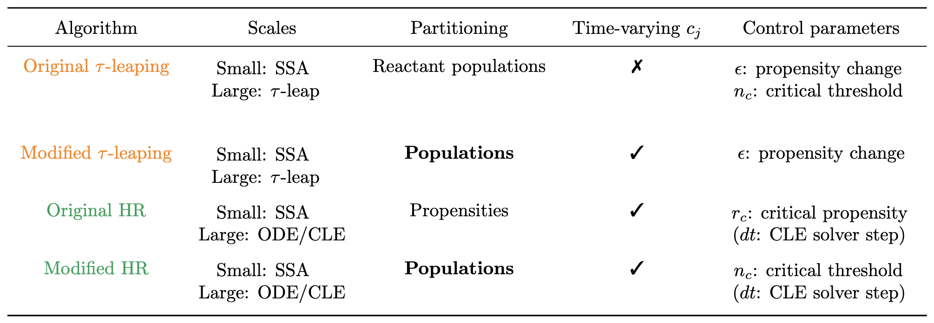
Summary
If you have stable separation of scales, partitioning is best
Tau-leaping is parsimonious and flexible.
Consider using both and comparing results if sensitive time dependence

Slide 23
Future directions
Multi-level Monte Carlo
Adaptive step size for stochastic differential equation solver
GPU integration using Julia

Slide 24

Acknowledgements
PI: Alison Hill
Hill lab: Anjalika, Maddie, Vivek, Anne, Anisha, and Natalia, who all gave wonderful feedback on an earlier version of this presentation
Johns Hopkins Rockfish cluster staff

